Slide 1


Estimation of brain tissue microstructure with dMRI
MediCSS 2022
Michele Guerreri
m.guerreri@ucl.ac.uk

Slide 2
Aim of the project
To explore different approaches of estimating brain tissue microstructure parameters from diffusion MRI data.

Slide 3
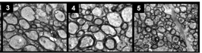
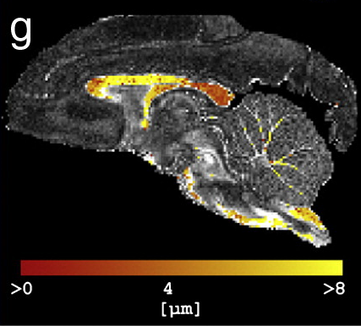
Why is this relevant?
The central vision in microstructure imaging is of virtual histology.
Classical histology
Virtual histology
Barazany, Daniel, Peter J. Basser, and Yaniv Assaf. Brain 132.5 (2009): 1210-1220.
Alexander, Daniel C., et al. Neuroimage 52.4 (2010): 1374-1389.

Slide 4
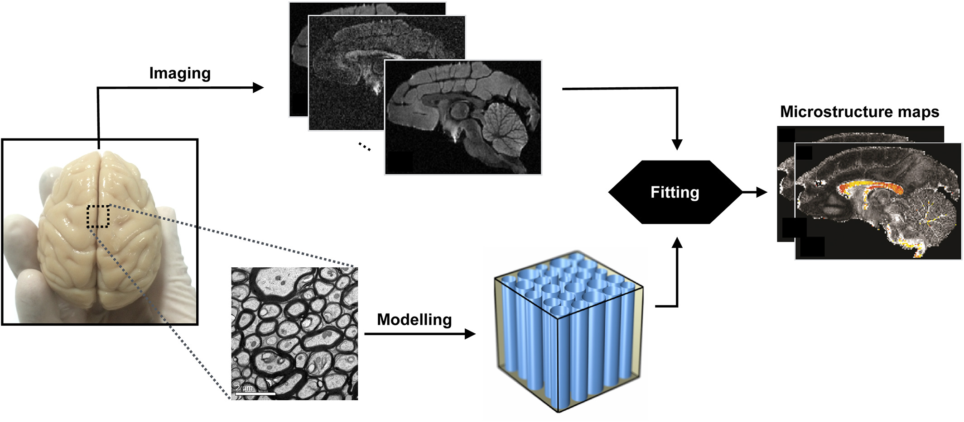
How can we do it?
We rely on a model that relates microscopic features of tissue architecture to MR signals.
Alexander, Daniel C., et al. NMR in Biomedicine 32.4 (2019): e3841.

Slide 5
How can we do it?
We rely on a model that relates microscopic features of tissue architecture to MR signals.
Alexander, Daniel C., et al. NMR in Biomedicine 32.4 (2019): e3841.

Slide 6
How can we do it?
We rely on a model that relates microscopic features of tissue architecture to MR signals.
Alexander, Daniel C., et al. NMR in Biomedicine 32.4 (2019): e3841.

Slide 7
How can we do it?
We rely on a model that relates microscopic features of tissue architecture to MR signals.
Alexander, Daniel C., et al. NMR in Biomedicine 32.4 (2019): e3841.

Slide 8
How can we do it?
We rely on a model that relates microscopic features of tissue architecture to MR signals.
Diffusion MRI is a key modality because of its unique sensitivity to cellular architecture.
Alexander, Daniel C., et al. NMR in Biomedicine 32.4 (2019): e3841.

Slide 9
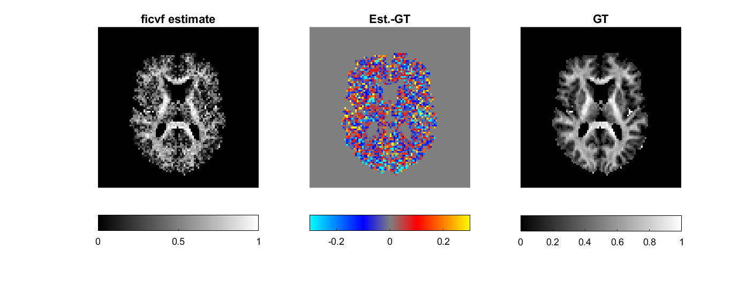
Parameter estimation - a key step.
Parameter estimation can be challenging.
Ground truth parameter map
Unsuccessful estimation

Slide 10
Parameter estimation - a key step.
Parameter estimation can be challenging.
Ground truth parameter map
Unsuccessful estimation
There exist many ways of tackling this problem.

Slide 11
Conventional parameter estimation
Problem statement:
We need to find the parameters (1) that make the data the model predicts (2) as close (3) as possible (4) to the data we observe.
Let’s break it down…

Slide 12
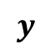
Conventional parameter estimation – key ingredients
We have some data
y
$$y$$
x

Slide 13
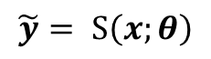
Conventional parameter estimation – key ingredients
We have some data
We identify a model
y
$$y$$
y
$$\tilde{y}= S\left(x;θ\right)$$
x
x

Slide 14
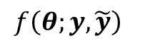
Conventional parameter estimation – key ingredients
We have some data
We identify a model
y
$$y$$
y
$$\tilde{y}= S\left(x;θ\right)$$
x
x
We need to measure closeness
y
$$f\left(θ;y,\tilde{y}\right)$$
x

Slide 15
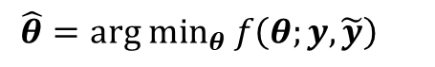
Conventional parameter estimation – key ingredients
We have some data
We identify a model
y
$$y$$
y
$$\tilde{y}= S\left(x;θ\right)$$
x
x
We need a systematic way to improve the parameter estimation
We need to measure closeness
y
$$f\left(θ;y,\tilde{y}\right)$$
y
$$\hat{θ}={arg min}_{θ} f\left(θ;y,\tilde{y}\right)$$
x
x
x

Slide 16
Conventional parameter estimation - cons
Sub-optimal solutions are often found corresponding to a local minimum.
The procedure must be repeated for each voxel.
Can be extremely slow.
Cab be computationally very expensive.

Slide 17
Machine learning as alternative
Machine learning (ML) and more specifically deep learning (DL) proposed as an alternative to overcome some conventional parameter estimation limitations.
Can be trained off-line and then deployed almost instantaneously.
Offer more stable solutions when trained accurately.

Slide 18
ML-based parameter estimation
Problem statement (supervised learning):
We need to learn a function (1) that can predict the parameters of interest (2) from the data observed (3), given a set of observed data and parameters of interest pairs (4) exampling the relation between the two.
Let’s break it down…

Slide 19
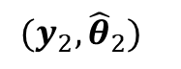
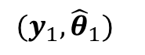
ML-based parameter estimation – key ingredients
We have some data and connected parameters
y
y
…
x
$$(y_{2},{\hat{θ}}_{2})$$
x
$$(y_{1},{\hat{θ}}_{1})$$

Slide 20
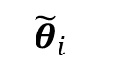
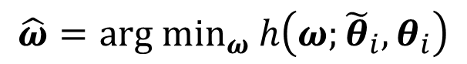
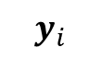
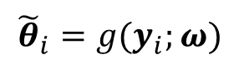
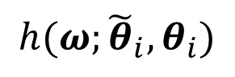
ML-based parameter estimation – key ingredients
We have some data and connected parameters
We need a function which connects the two
y
y
$${\tilde{θ}}_{i}=g(y_{i};ω)$$
…
$$y_{i}$$
$${\tilde{θ}}_{i}$$
x
$$(y_{2},{\hat{θ}}_{2})$$
x
$$(y_{1},{\hat{θ}}_{1})$$
We need to measure closeness between estimated and true parameters
We need a systematic way to vary the function to improve the estimation
$$h(ω;{\tilde{θ}}_{i},θ_{i})$$
$$\hat{ω}={arg min}_{ω} h\left(ω;{\tilde{θ}}_{i},θ_{i}\right)$$

Slide 21
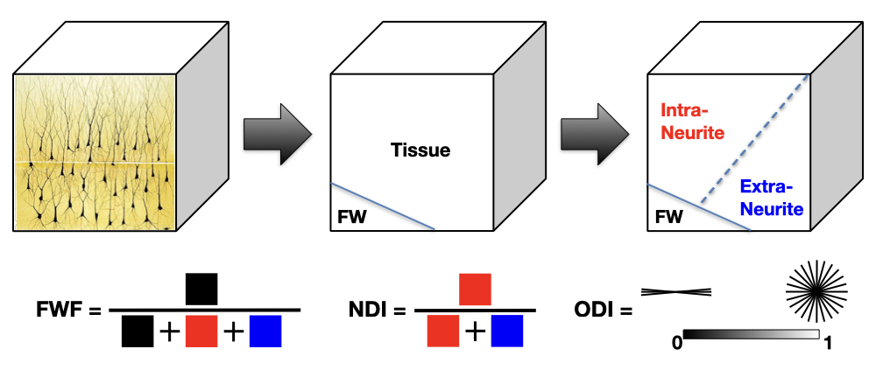
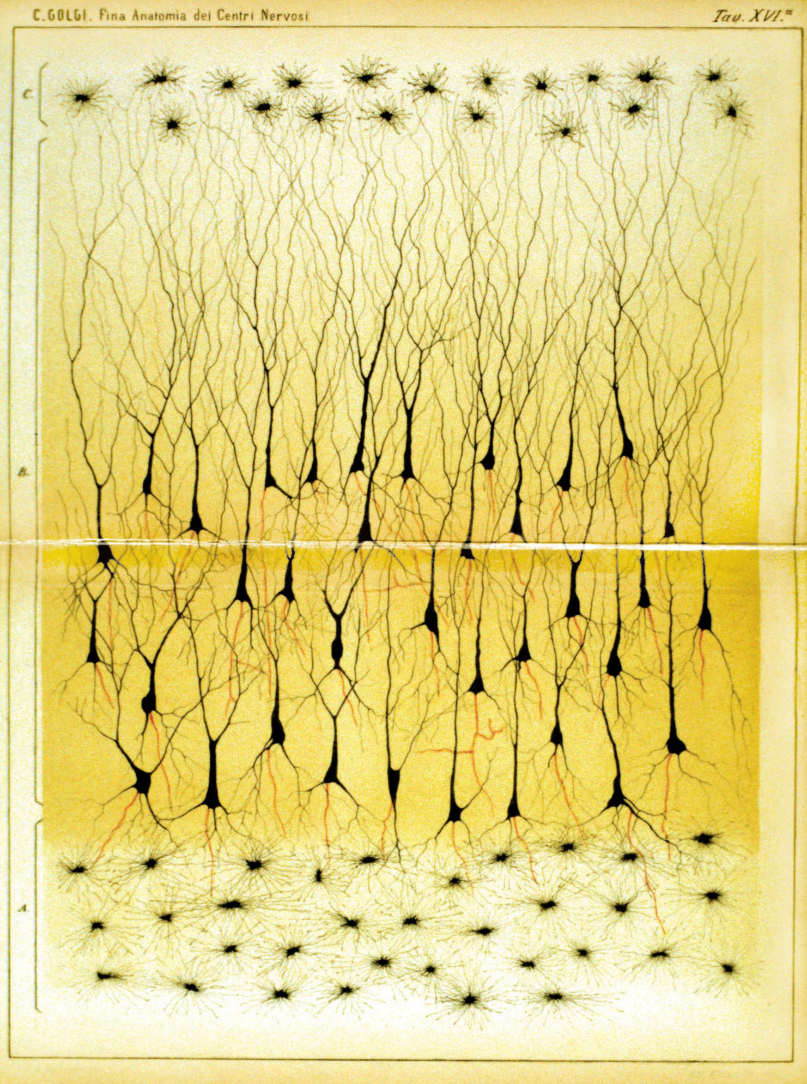
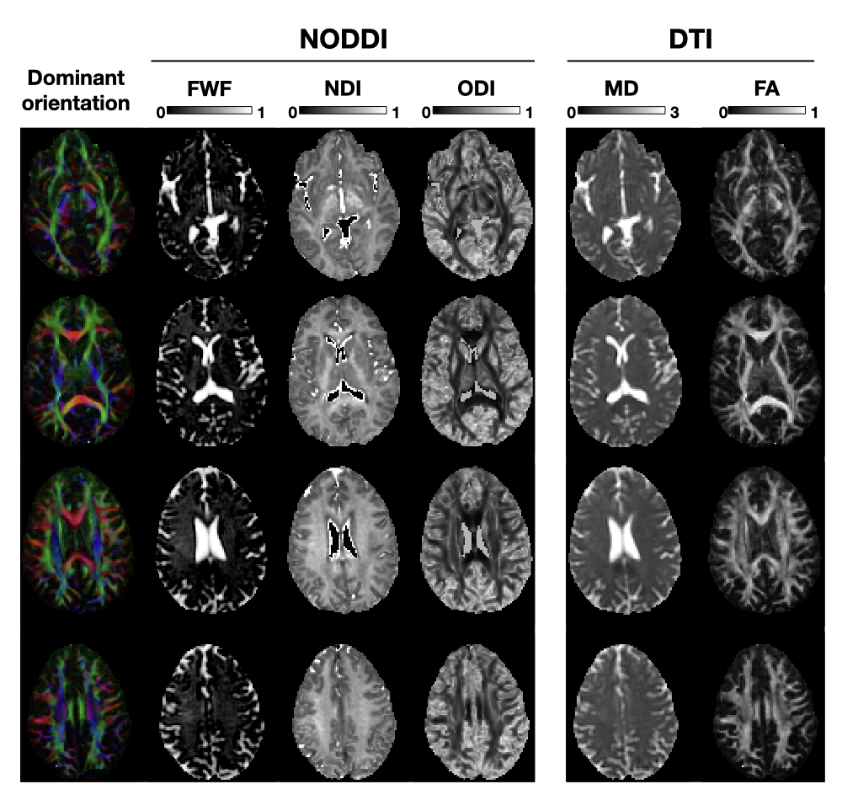
Neurite Orientation Dispersion and Density
Imaging (NODDI)
Tissue Morphology
[1]
[1] WIKIMEDIA COMMONS. 2012. File: Golgi 1885 Plate XVI.JPG: https://commons.wikimedia.org/wiki/File:Golgi_1885_Plate_XVI.JPG

Slide 22
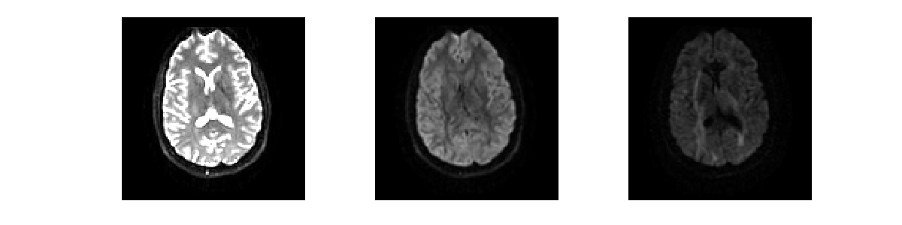
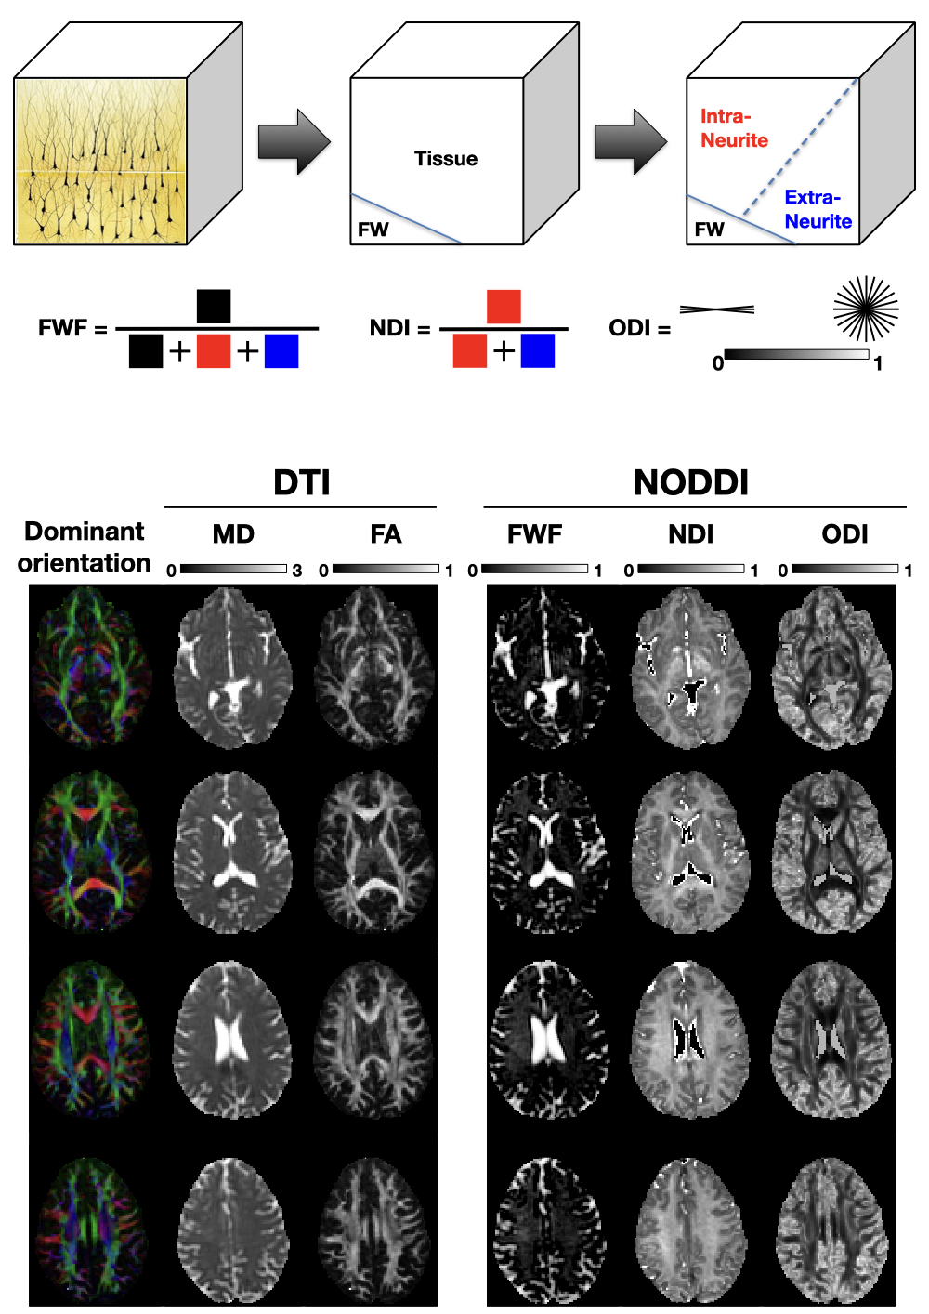
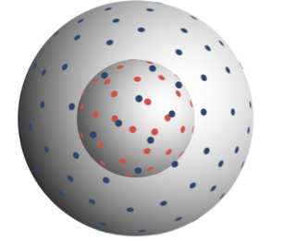
NODDI as example
Neurite orientation dispersion and density imaging (NODDI): a popular microstructure imaging model in neuroimaging.
Input
Output

Slide 23
What are you going to learn?
How to access and manipulate DWI data in Matlab.
How to explore diffusion data.
NODDI input and output, how to generate DW signal from the forward model.
How to run the parameter estimation via the conventional approach.
How to assess the parameter estimation performance.
How to run the parameter estimation via DL.
How to compare the two approaches.

